Slide 1
Tropical surge 29 Nov – 2 Dec 2014 and Landfall Conditions at 800 AM PT on 2 Dec
Marty Ralph
Center for Western Weather and Water Extremes (CW3E) at
UC San Diego’s Scripps Institution of Oceanography
SSM/I images from NOAA/PSD - Wick
http://www.esrl.noaa.gov/psd/psd2/coastal/satres/data/images/wx_cl/wvp/

Slide 2
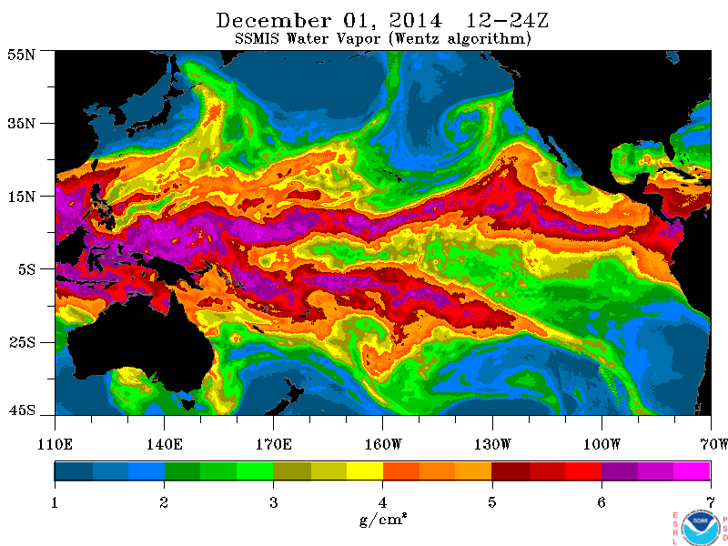

Slide 3
Track emerging AR signature
Near the low (IWV > 3 cm)
Track circulation center as inferred from SSM/I IWV pattern
Track northern edge of tropical surge (IWV = 4 cm)

Slide 4
Tropical surge and developing cut-off low – IWV isochrones
27 PM
28 AM
28 PM
29 AM
45 N
Day of month (Nov or Dec) and AM or PM composite
35 N
25 N
15 N
Contours are SSM/I-observed IWV = 4 cm contour
marking the north edge of tropical water vapor reservoir
5 N
160 W
140 W
120 W
100 W

Slide 5
Tropical surge and developing cut-off low – IWV isochrones
27 PM
28 AM
28 PM
29 AM
29 PM
45 N
Day of month (Nov or Dec) and AM or PM composite
35 N
25 N
15 N
Contours are SSM/I-observed IWV = 4 cm contour
marking the north edge of tropical water vapor reservoir
5 N
160 W
140 W
120 W
100 W

Slide 6
Tropical surge and developing cut-off low – IWV isochrones
27 PM
28 AM
28 PM
29 AM
29 PM
45 N
30 AM
Day of month (Nov or Dec) and AM or PM composite
35 N
25 N
15 N
Contours are SSM/I-observed IWV = 4 cm contour
marking the north edge of tropical water vapor reservoir
5 N
160 W
140 W
120 W
100 W

Slide 7
Tropical surge and developing cut-off low – IWV isochrones
27 PM
28 AM
28 PM
29 AM
29 PM
45 N
30 AM
30 PM
Day of month (Nov or Dec) and AM or PM composite
35 N
25 N
Low center from SSM/I
15 N
Contours are SSM/I-observed IWV = 4 cm contour
marking the north edge of tropical water vapor reservoir
5 N
160 W
140 W
120 W
100 W

Slide 8
Tropical surge and developing cut-off low – IWV isochrones
27 PM
28 AM
28 PM
29 AM
29 PM
45 N
30 AM
30 PM
01 AM
Day of month (Nov or Dec) and AM or PM composite
35 N
25 N
Low center from SSM/I
15 N
IWV > 3 cm near cut-off low
Contours are SSM/I-observed IWV = 4 cm contour
marking the north edge of tropical water vapor reservoir
5 N
160 W
140 W
120 W
100 W

Slide 9
Tropical surge and developing cut-off low – IWV isochrones
27 PM
28 AM
28 PM
29 AM
29 PM
45 N
30 AM
30 PM
01 AM
01 PM
Day of month (Nov or Dec) and AM or PM composite
35 N
25 N
Low center from SSM/I
15 N
IWV > 3 cm near cut-off low
Contours are SSM/I-observed IWV = 4 cm contour
marking the north edge of tropical water vapor reservoir
5 N
160 W
140 W
120 W
100 W

Slide 10
Tropical surge and developing cut-off low – IWV isochrones
27 PM
28 AM
28 PM
29 AM
29 PM
45 N
30 AM
30 PM
01 AM
01 PM
02 11 Z
Day of month (Nov or Dec) and AM or PM composite
35 N
25 N
Low center from SSM/I
15 N
IWV > 3 cm near cut-off low
Contours are SSM/I-observed IWV = 4 cm contour
marking the north edge of tropical water vapor reservoir
5 N
160 W
140 W
120 W
100 W

Slide 11
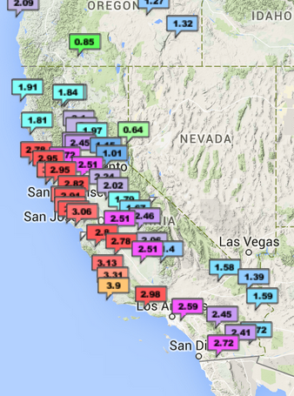
GPS-Met IWV Network Obs
At 600 AM PT 2 Dec 2014
Note the broad area of near or > 3 cm IWV
Note the max IWV value of 3.9 cm marks
The leading edge of the > 4 cm tropical surge
600 AM PT Tues 2 Dec

Slide 12
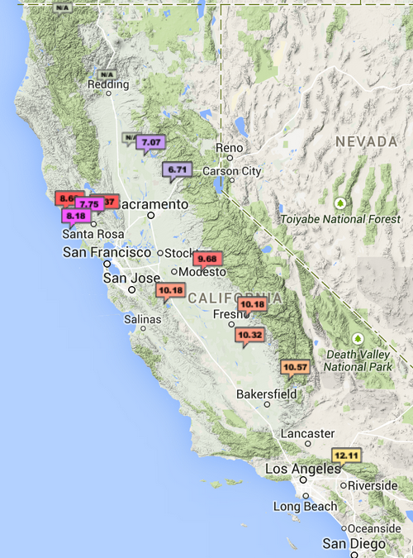
Snow-level radar Network Obs
At 830 AM PT 2 Dec 2014
Snow levels in landfalling storm
7000 ft in northern Sierra
8000 ft in coastal (Russian River) area
10000 ft in southern Sierra
12000 ft in LA mountains
830 AM PT 2 Dec

Slide 13
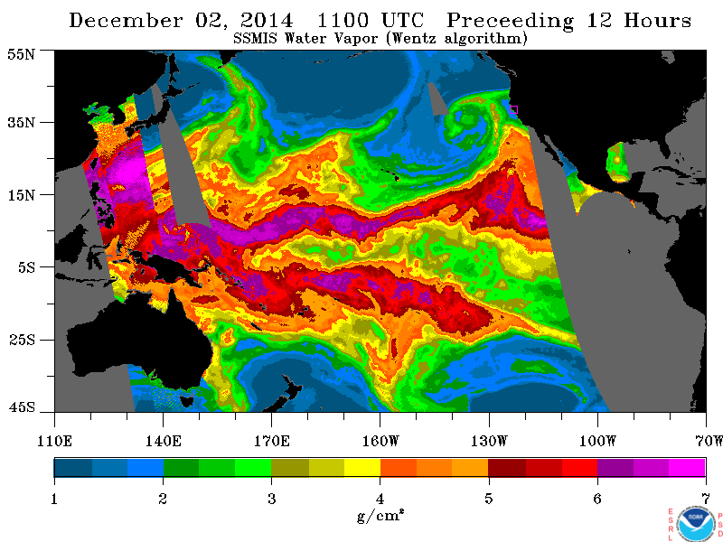

Slide 14
01 PM

Slide 15
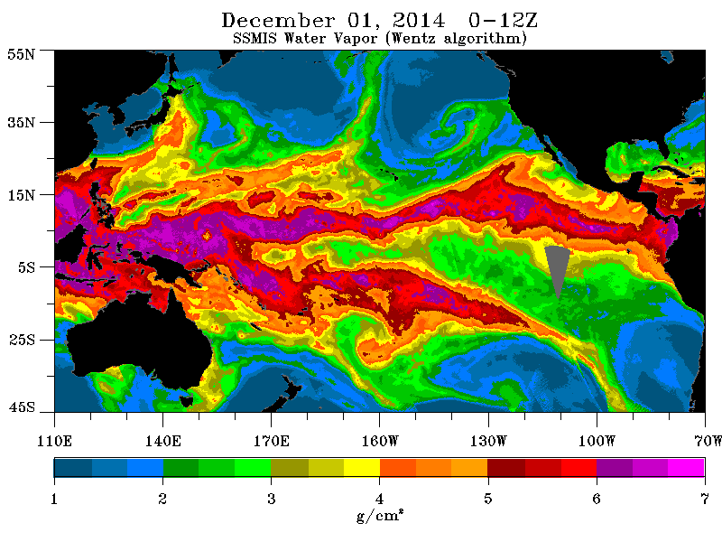
01 AM

Slide 16
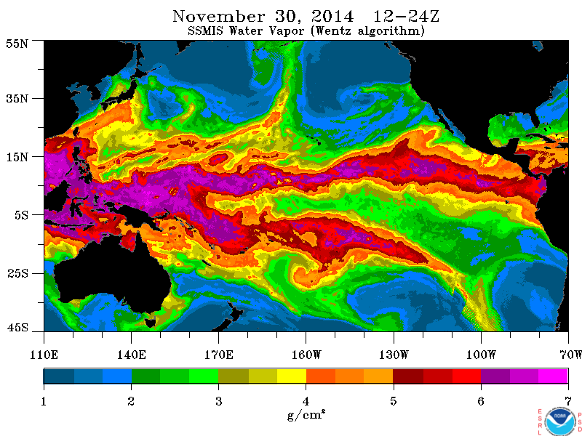
30 PM

Slide 17
Original to scale
45 N
35 N
25 N
15 N
5 N
160 W
140 W
120 W
100 W
27 PM
28 AM
28 PM
29 AM
29 PM
30 AM
30 PM
01 AM
01 PM
Day of month (Nov or Dec) and AM or PM composite

